Slide 1
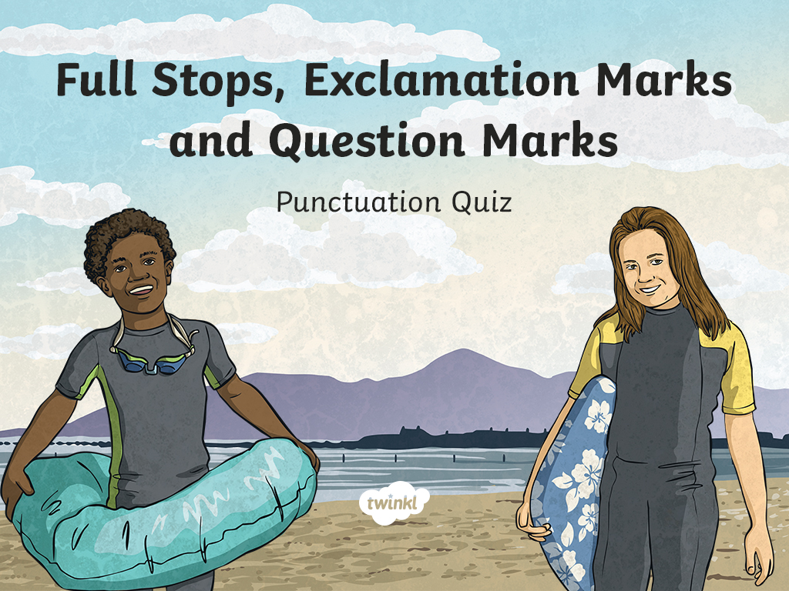

Slide 2
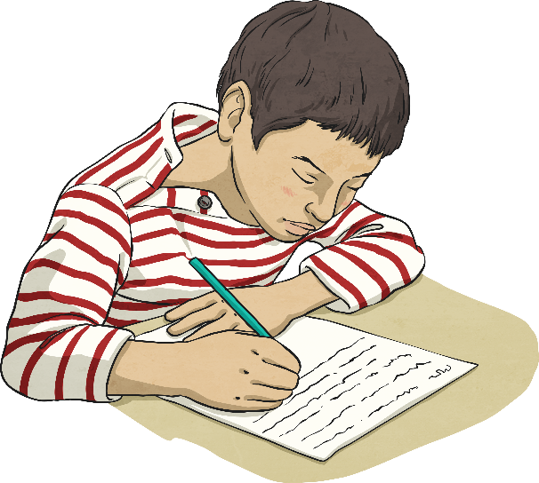
Choose the correct punctuation for the sentence.
He works very well in his maths lesson.
He works very well in his maths lesson
.
?
!

Slide 3
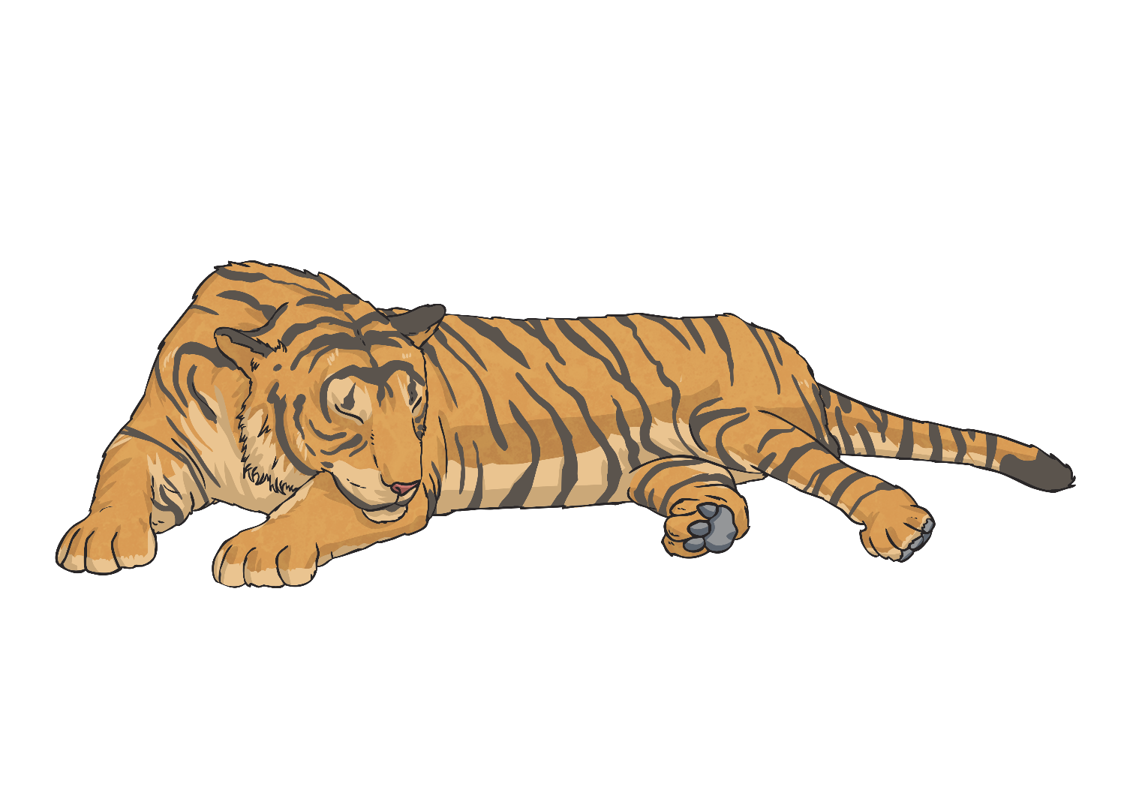
Choose the correct punctuation for the sentence.
How exciting, I love going to the zoo!
How exciting, I love going to the zoo
.
?
!

Slide 4

Choose the correct punctuation for the sentence.
Where are you going on holiday this year?
Where are you going on holiday this year
.
?
!

Slide 5

Choose the correct punctuation for the sentence.
What an amazing piece of writing!
What an amazing piece of writing
.
?
!

Slide 6
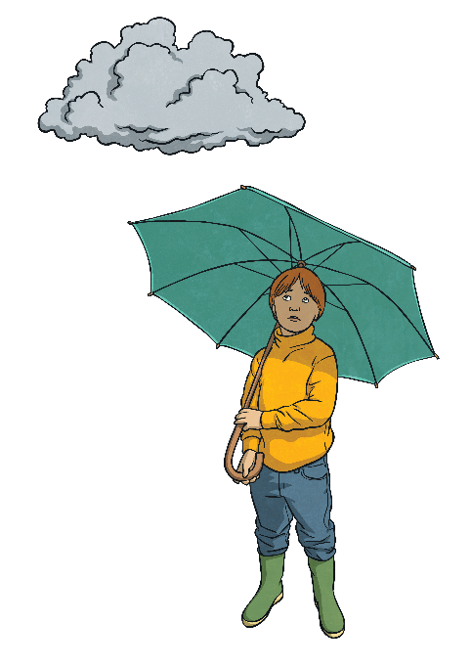
Choose the correct punctuation for the sentence.
I don’t like damp weather.
I don’t like damp weather
.
?
!

Slide 7
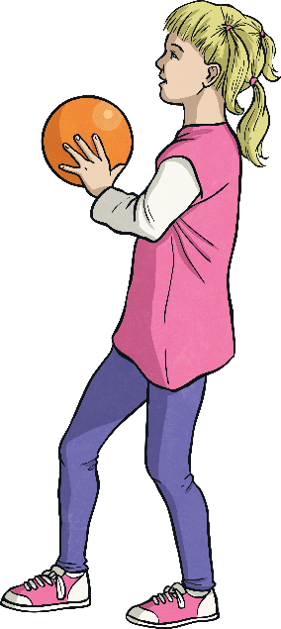
Choose the correct punctuation for the sentence.
Watch out!
Watch out
.
?
!

Slide 8
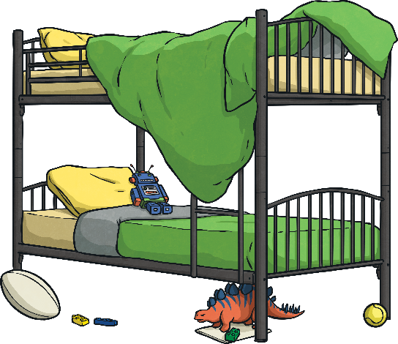
Choose the correct punctuation for the sentence.
What a mess!
What a mess
.
?
!

Slide 9
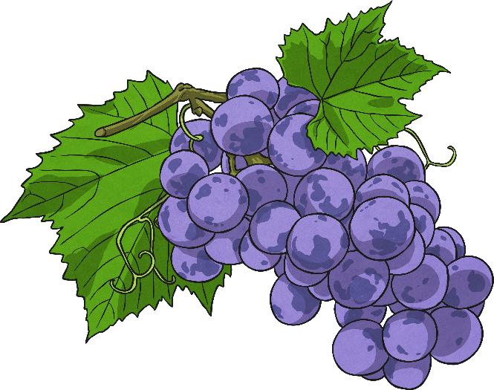
Choose the correct punctuation for the sentence.
Grapes are my favourite fruit.
Grapes are my favourite fruit
.
?
!

Slide 10
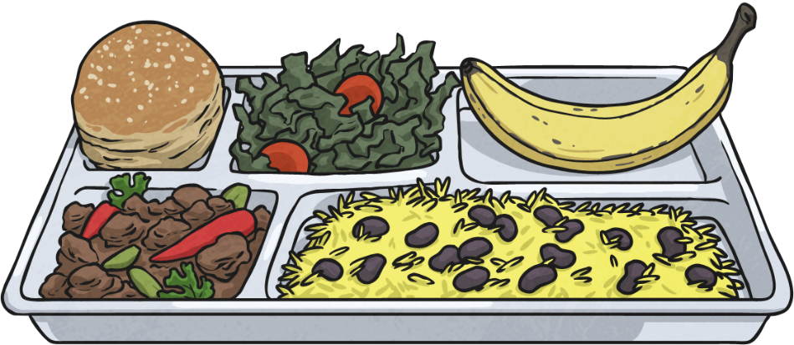
Choose the correct punctuation for the sentence.
What are you having for lunch?
What are you having for lunch
.
?
!

Slide 11
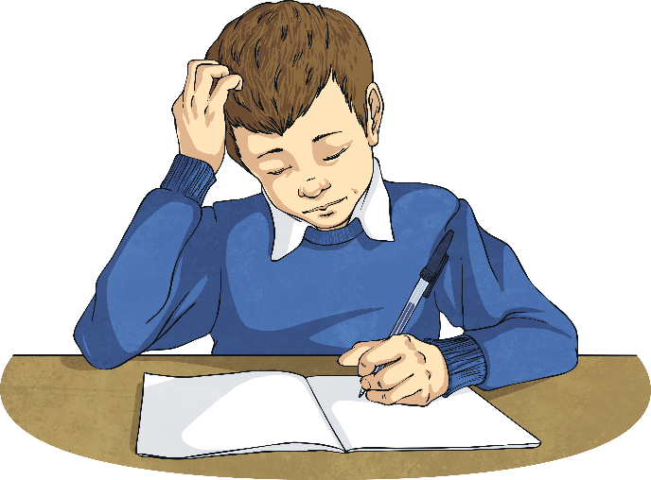
Choose the correct punctuation for the sentence.
Have you done your homework?
Have you done your homework
.
?
!

Slide 12
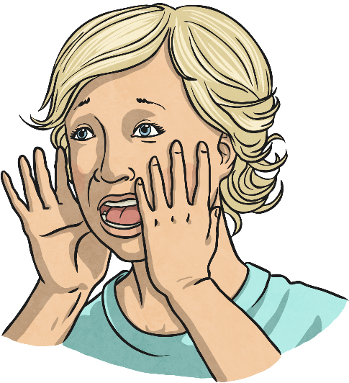
Choose the correct punctuation for the sentence.
How ridiculous!
How ridiculous
.
?
!

